Slide 1
Mongo db relational queries
Aswin p p

Slide 2
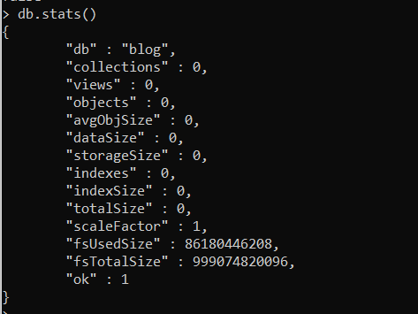
Statistics of database before Insertion of documents

Slide 3
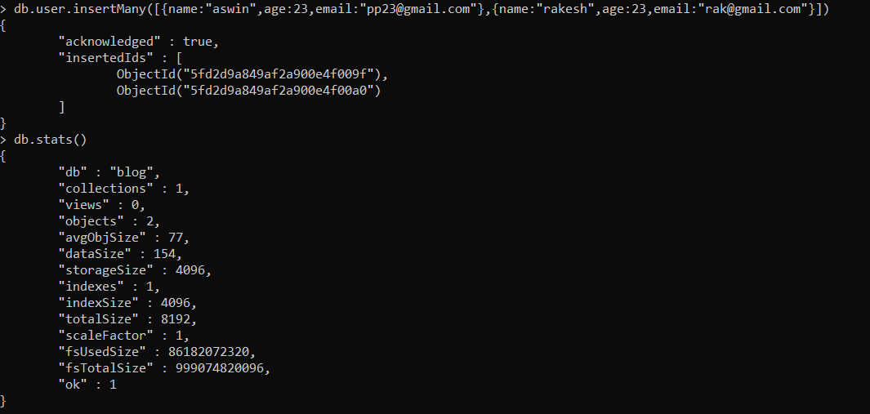
Statistics of database after Insertion of documents

Slide 4

Displaying the datatype of a variable

Slide 5
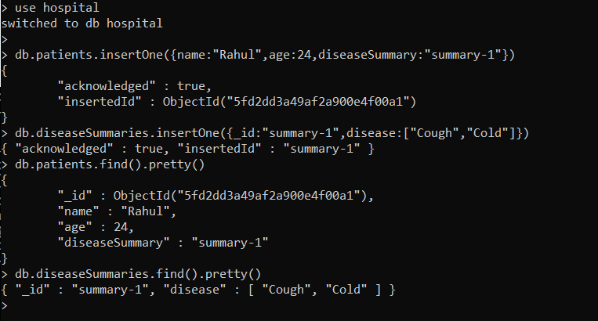
Patient-Disease Relationship (One - One)

Slide 6
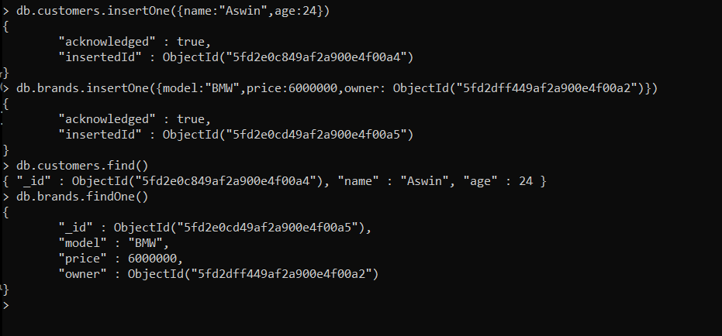
Customer - Car Relationship (One - One)

Slide 7
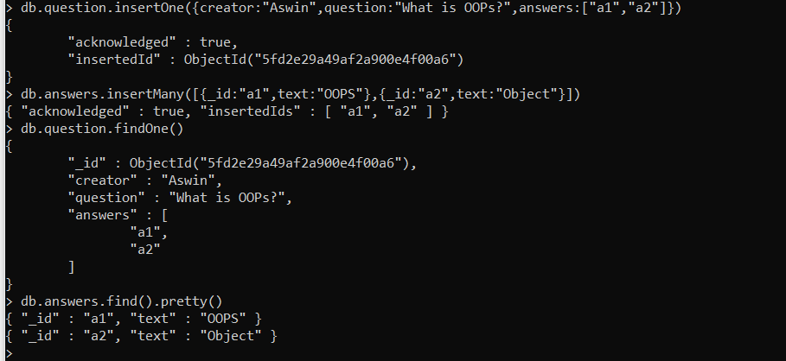
Question – Answer Relationship (One - Many)

Slide 8
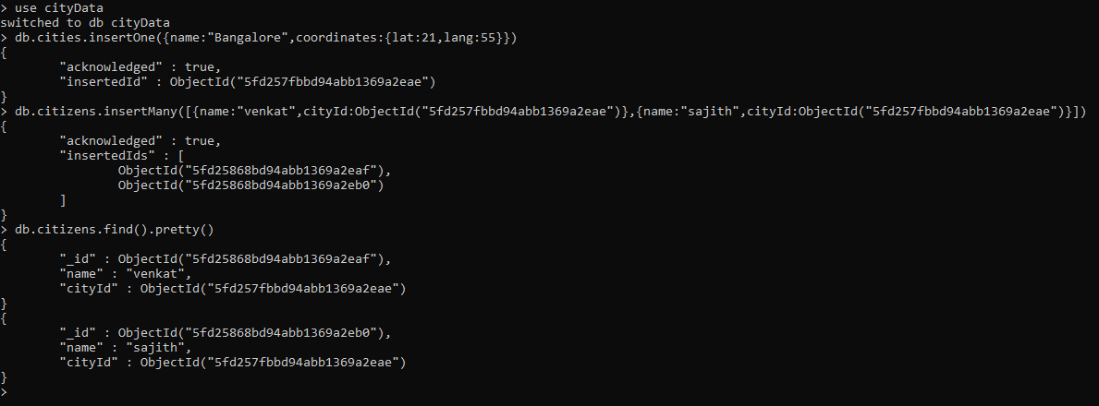
Location – Person Relationship (One – Many)

Slide 9
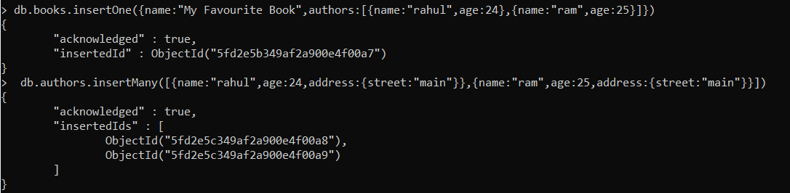
Book – Authors Relationship (Many – Many)

Slide 10
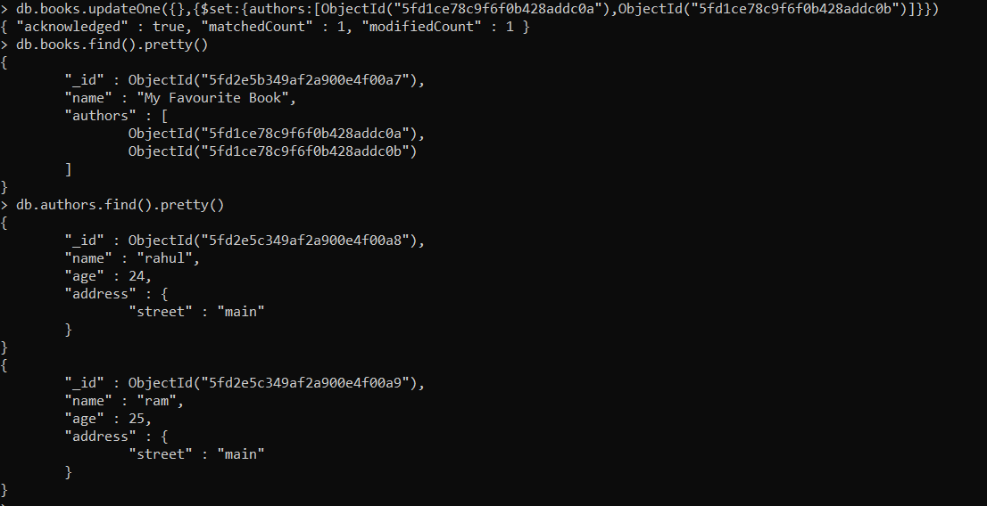

Slide 11
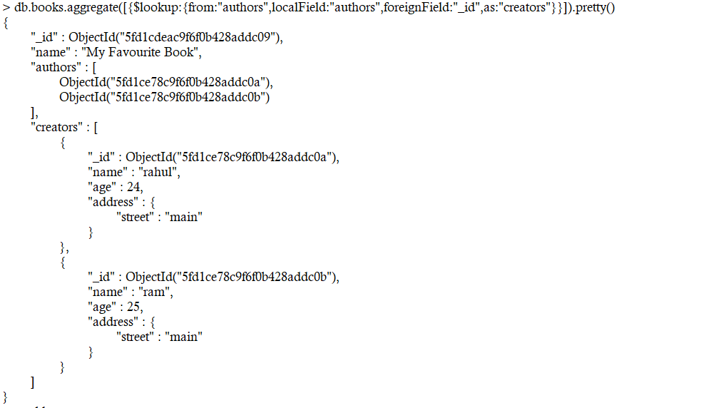
Books – Author Aggregate

Slide 12
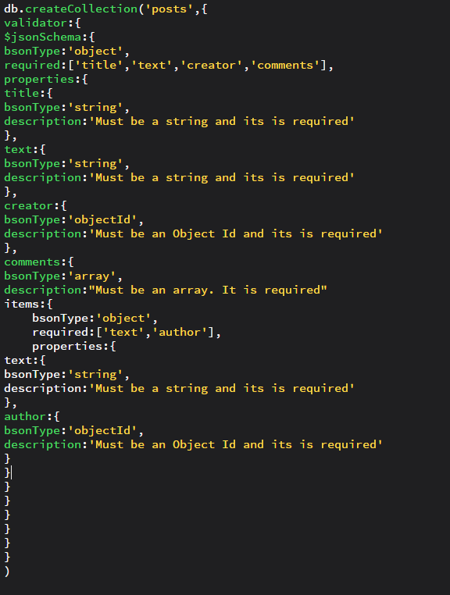
Schema Validation

Slide 13
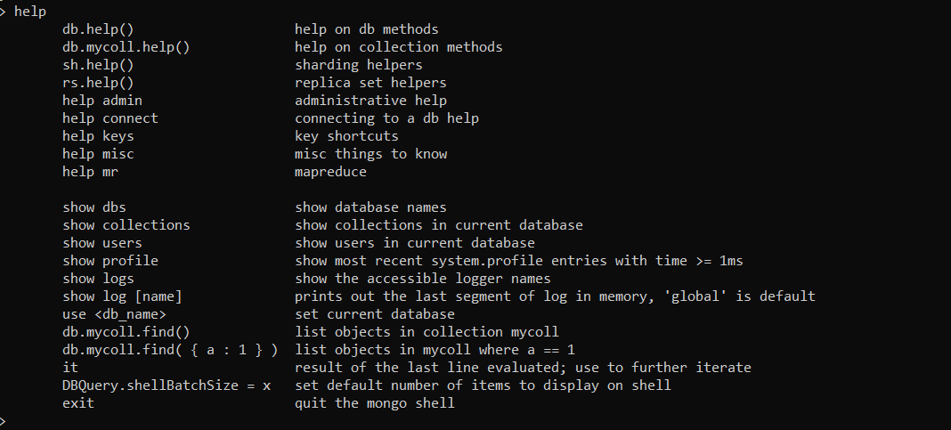
Help

Slide 14
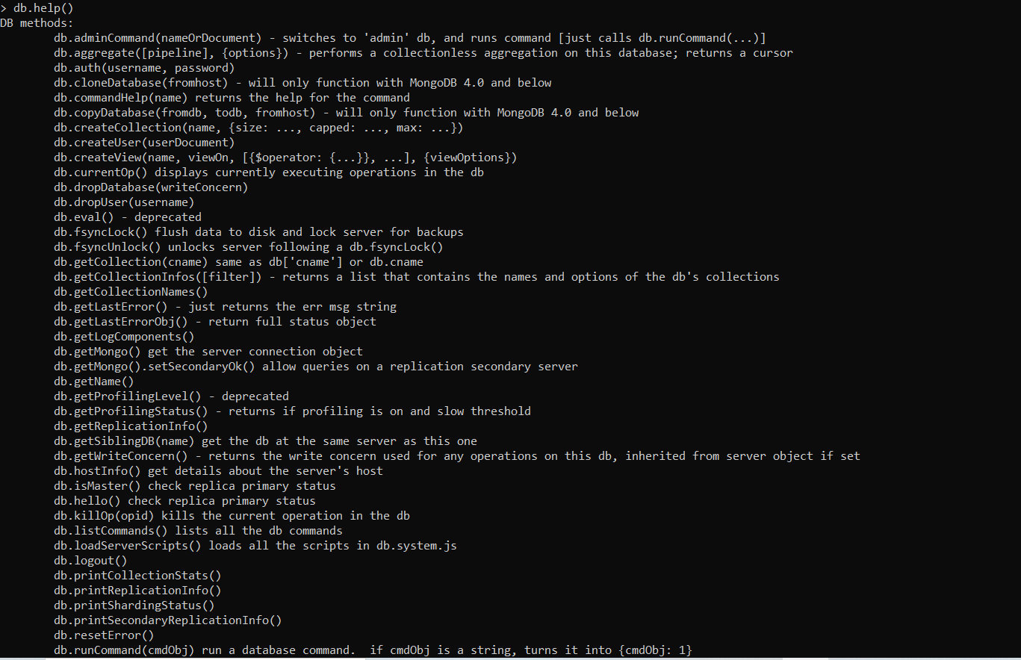
db.help()

